Slide 1

Automated Payroll Excellence with
Efficiency and Precision at Your Fingertips

Slide 2

Meet The Team Behind
Md Nishadul Islam Chy Shezan
Rimjhim Dey
Mohammad Sakib
Mou Chakrabarty

Slide 3


Table Of Contents
Introduction
Overview of PayCraft
Technologies Used
System Architecture
Features and Functionalities
Benefits of PayCraft
Challenges and Solutions
Future Enhancements
Conclusion

Slide 4
Introduction
Welcome to our presentation on PayCraft - An Automated Payroll System designed for efficiency and accuracy in payroll management. PayCraft simplifies payroll processing, saves time, and ensures precision in payments. Powered by HTML, CSS, Bootstrap, JavaScript, and JSON, PayCraft offers a user-friendly interface and robust backend architecture. Let's explore how PayCraft transforms payroll management, empowering businesses with its user-friendly interface and robust backend architecture.

Slide 5


Overview of PayCraft
Streamlined Payroll Management:
Simplifies payroll processes from login to payment, ensuring efficiency and accuracy.
User-Friendly Interface:
Intuitive interface for seamless navigation, making payroll management accessible to all users.
Customizable Options:
Allows customization of payroll settings, including employee details and payment methods.
Comprehensive Overview:
Provides a comprehensive overview with company details, employee profiles, and transaction history.
Flexible Operations:
Enables actions such as adding employees, making payments, and choosing payment options with ease.

Slide 6

Technologies Used
HTML (Hypertext Markup Language):
Utilized to structure and create the content of web pages in PayCraft.
CSS (Cascading Style Sheets):
Employed for styling and formatting elements within the PayCraft web application, ensuring a visually appealing interface.
Bootstrap:
Integrated for responsive design and layout of PayCraft, guaranteeing compatibility across various devices and screen sizes.
JavaScript:
Implemented for interactive features and functionality within the PayCraft user interface, enhancing user experience with dynamic elements.
JSON (JavaScript Object Notation):
Employed for data interchange between the frontend and backend systems of PayCraft, facilitating seamless communication and efficient data handling.

Slide 7
System Architecture
User Authentication:
Log In: Users can log in to their accounts with their credentials.
Sign Up: New users can create an account to access PayCraft.
Dashboard Overview:
Company Overview: Provides a summary of the company's payroll information.
Employee Overview: Displays a list of employees and their details.
Transaction History: Shows a history of payments made.
Functionality Sections:
Add Employee: Allows the user to add a new employee to the system.
Make Payment: Enables the user to initiate payroll payments.
Add Payment Option: Provides options for adding payment methods like bank transfer, bKash, card, etc.
Form Sections:
Add Employee Form: Includes fields for entering employee details.
Add Payment Form: Displays options for different payment methods.
Workspace Options:
Join Workspace: Allows users to join an existing company's workspace.
Create Company: Provides a form for creating a new company profile, including employer details.

Slide 8
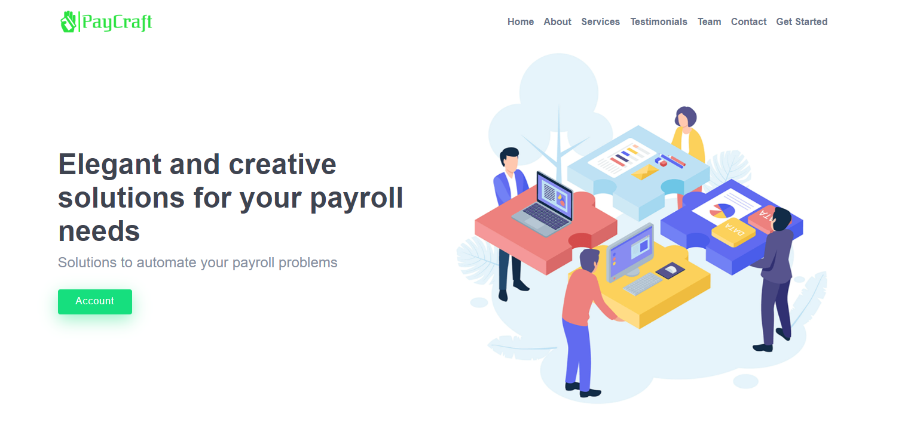
Features and Functionalities

Slide 9
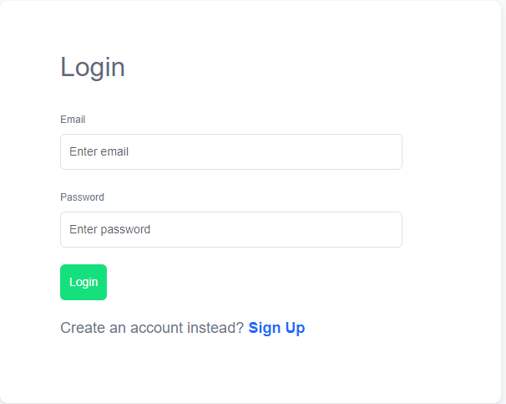
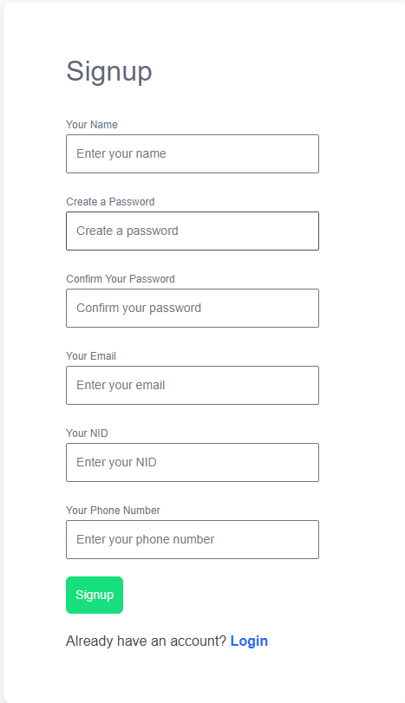
Login: Secure Access to PayCraft
Sign Up: Create Your PayCraft Account

Slide 10
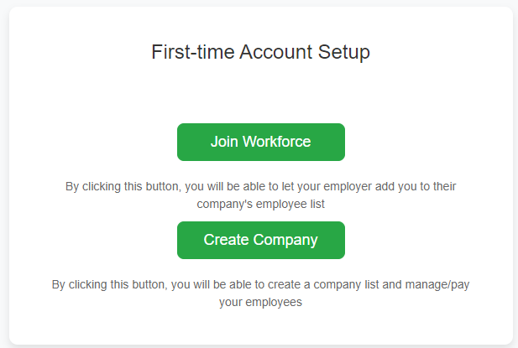
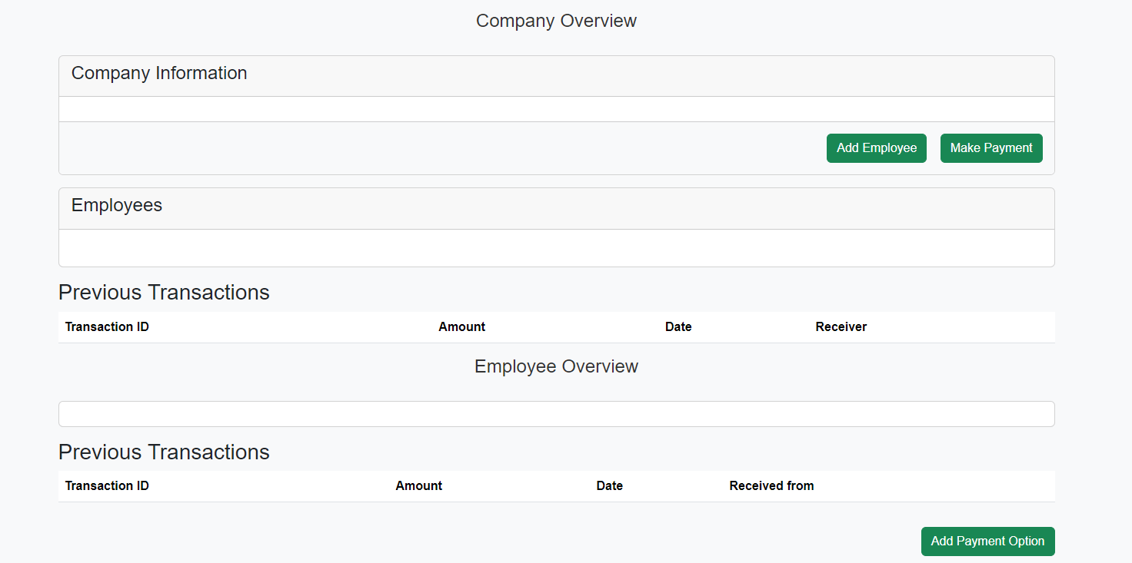
Overview: PayCraft at a Glance

Slide 11
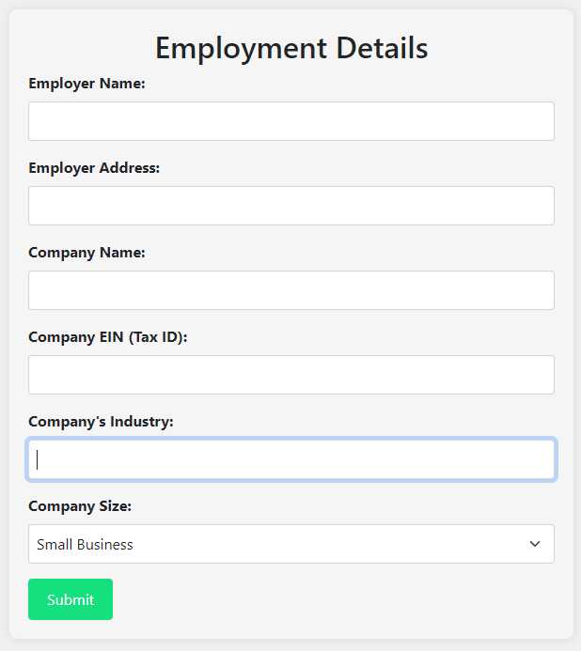
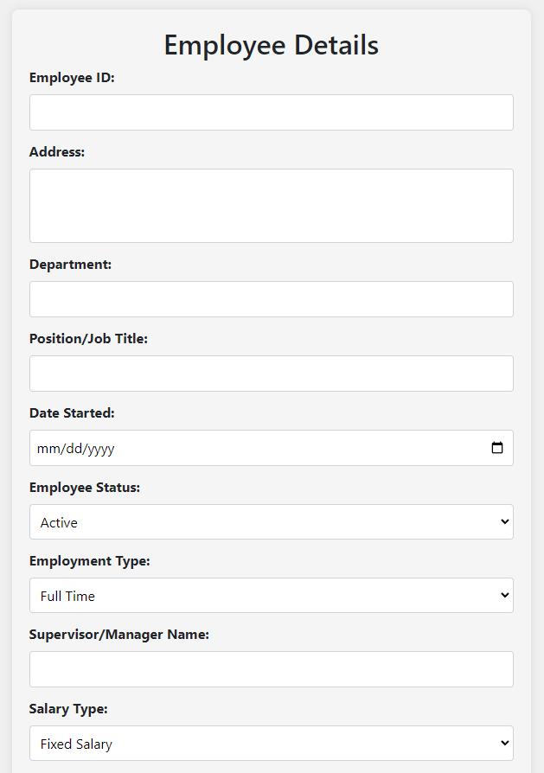
Employment Form: Company Profile Setup
Employee Form: Add New Employee Details

Slide 12
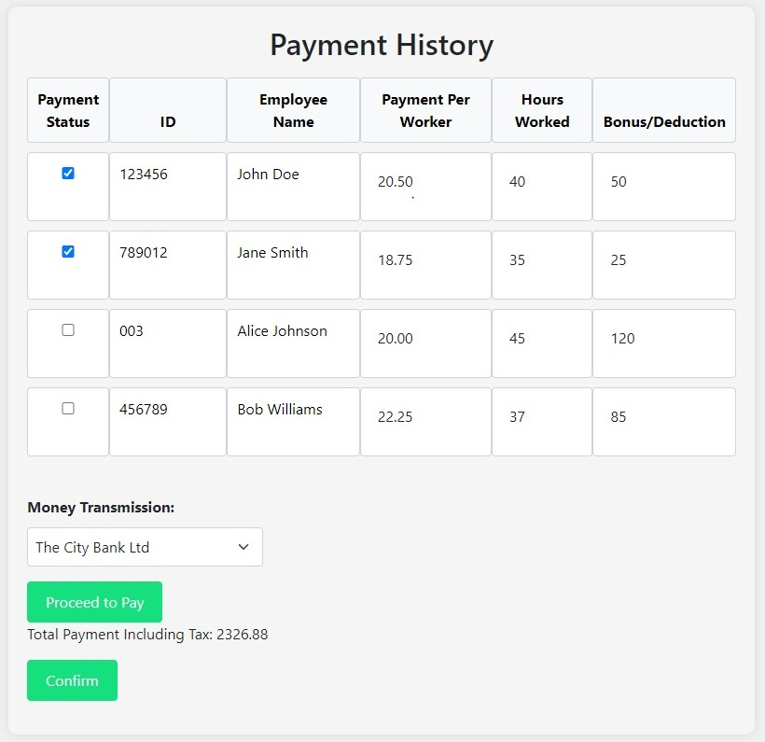
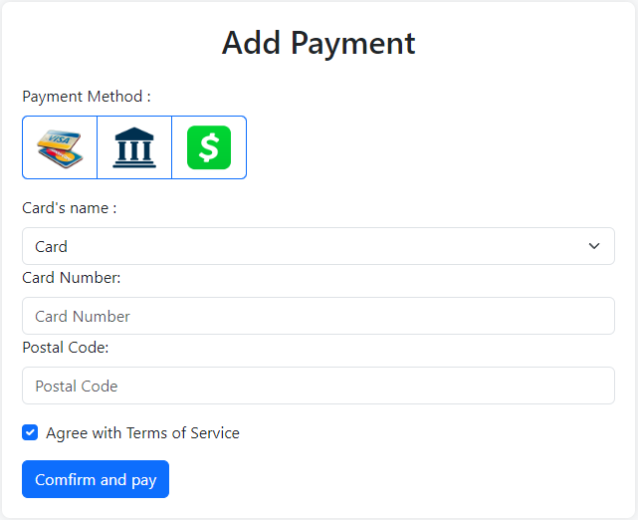
Payment History: Track Payments and Taxes
Add Payment: Choose Payment Method

Slide 13


Benefits of PayCraft
Efficiency
Accuracy
Compliance
Employee Management
Customization
User-Friendly
Flexible Payments
Responsive Design
Productivity

Slide 14


Challenges
Team collaboration and individual concerns.
Managing data with JSON.
Dynamic features with JavaScript.
Page structure and CSS consistency.
Solutions
Cohesive teamwork and constant approach.
Efficient data handling techniques.
Thorough testing and debugging of JavaScript code.
Adoption of best practices in CSS architecture.

Slide 15

Future Enhancements
Advanced Reporting and Analytics
Integration with Third-Party Services
Artificial Intelligence Integration
Implementation of Server for improved Performance and Data Management
This Photo by Unknown Author is licensed under CC BY-SA-NC

Slide 16


Conclusion
embodies our team's collaborative spirit and commitment to innovation. This project has not only provided a valuable solution for payroll management but has also been a learning experience for us. Through challenges and successes, we've gained valuable insights and skills that will guide us in future endeavors. We're proud of what we've achieved and look forward to applying our newfound knowledge to create even greater impact.
Thank you for your attention and support.
This Photo by Unknown Author is licensed under CC BY

